Slide 1
BASAVARAJESWARI GROUP OF INSTITUTIONS
Ballari Institute of Technology & Management
AUTONOMOUS INSTITUTE UNDER VISVESVARAYA TECHNOLOGICAL UNIVERSITYJNANA SANGAMA, BELAGAVI 590018
INTERNSHIP
Report On
CUSTOM WORKOUT PLANNING
Submitted in partial fulfillment of the requirements for the award of degree of
Bachelor of Engineering In
ARTIFICIAL INTELLIGENCE AND MACHINE LEARNING
Submitted by
KARUTURI NANDINI
3BR22AI078
Internship Carried Out By
EZ TRAININGS & TECHNOLOGIES PVT.LTD
HYDERABAD
Internal Guide
Tousiff
Asst.prof,AIML
Santosh
Asst. prof,AIML
External Guide
Bijen Singha
Technical Trainer
BALLARI INSTITUTE OF TECHNOLOGY & MANAGEMENT
NACC Accredited Institution*
(Recognized by Govt. of Karnataka, approved by AICTE, New Delhi & Affiliated to Visvesvaraya Technological University, Belagavi)
"Jnana Gangotri" Campus, No.873/2, Ballari-Hospet Road, Allipur, Ballar1-583 104 (Karnataka) (India)
Ph: 08392 – 237100 / 237190, Fax: 08392 – 237197
2023-2024

Slide 2


BASAVARAJESWARI GROUP OF INSTITUTIONS
BALLARI INSTITUTE OF TECHNOLOGY & MANAGEMENT
Autonomous institute under VISVESVARAYA TECHNOLOGICAL UNIVERSITYJNANA SANGAMA,
BELAGAVI 590018
NACC Accredited Institution*
(Recognized by Govt. of Karnataka, approved by AICTE, New Delhi & Affiliated to Visvesvaraya Technological University, Belagavi)
"JnanaGangotri"Campus,No.873/2,Ballari-HospetRoad,Allipur,
Ballar1-583 104 (Karnataka)(India)
Ph: 08392 – 237100 / 237190, Fax: 08392 –237197
DEPARTMENT OF
ARTIFICIAL INTELLIGENCE AND MACHINE LEARNING
CERTIFICATE
This is to certify that the Internship entitled “CUSTOM WORKOUT PLANNING” has been successfully completed by KARUTURI NANDINI bearing USN 3BR22AI078 a bonafide student of Ballari Institute of Technology and Management, Ballari. For the partial fulfillment of the requirementsfor the Bachelor’s Degree in ARTIFICIAL INTELLIGENCE AND MACHINE LEARNING of the VISVESVARAYA TECHNOLOGICAL UNIVERSITY, Belagavi during the academic year 2023-2024.
Signature of Internship Co-Ordinator
Tousiff
Asst.prof,AIML
Santosh
Asst.prof,AIML
Signature of HOD
Dr B.M.Vidyavathi
Prof. and HOD(AIML)

Slide 3
DECLARATION
I,KARUTURI NANDINI, second year student of Computer Science and Engineering, Ballari Institute of Technology, Ballari, declare that Internship entitled CUSTOM WORKOUT PLANNING is a part of Internship Training successfully carried out by EZ TECHNOLOGIES & TRAININGS PVT.LTD
,Hyderabad at “BITM,BALLARI”. This report is submitted in partial fulfillment of the requirements for the award of the degree, Bachelor of Engineering in Artificial Intelligence and Machine Learning of the Visvesvaraya Technological University, Belagavi.
Date : Place :
Signature of the Student

Slide 4
ACKNOWLEDGEMENT
The satisfactions that a company the successful completion of my internship on “CUSTOM WORKOUT PLANNING” would be incomplete without the mention of people who made it possible, whose noble gesture, affection, guidance, encouragement and support crowned my efforts with success. It is my privilege to express my gratitude and respect to all those who inspired me in the completion of my internship.
I am grateful to our respective coordinator “ TOUSIFF(Asst.prof,AIML) , SANTOSH (Asst.prof,AIML)” for his noble gesture, support co-ordination and valuable suggestions givento me in the completion of Internship.
I also thank Dr B.M.Vidyavathi, H.O.D. Department of Artificial Intelligence and Machine Learning for extending all his valuable support and encouragement.

Slide 5
Table of Contents
Chapter No. | Chapter Name | Page No.
1 | Company Profile | 01
2 | Day to day activity(student diary extract) | 02
3 | Abstract | 03
4 | Introduction of the project | 04
5 | Module Description | 05
6 | Algorithm | 06
7 | Output | 07-09
8 | Conclusion | 10
9 | References | 11

Slide 6
CHAPTER-1
COMPANY PROFILE
Company Name : EZ Trainings and Technologies Pvt. Ltd.
Introduction:
EZ Trainings and Technologies Pvt. Ltd. is a dynamic and innovative organization dedicated to providing comprehensive training solutions and expert development services. Established with a vision to bridge the gap between academic learning and industry requirements, we specialize in college trainings for students, focusing on preparing them for successful placements. Additionally, we excel in undertaking development projects, leveraging cutting-edge technologies to bring ideas to life.
Mission:
Our mission is to empower the next generation of professionals by imparting relevant skills and knowledge through specialized training programs. We strive to be a catalyst in the career growth of students and contribute to the technological advancement of businesses through our development projects.
Services:
College Trainings:
Tailored training programs designed to enhance the employability of students.
Industry-aligned curriculum covering technical and soft skills.
Placement assistance and career guidance.
Development Projects:
End-to-end development services, from ideation to execution.
Expertise in diverse technologies and frameworks.
Custom solutions to meet specific business needs.
Locations: Hyderabad | Delhi NCR
At EZ Trainings and Technologies Pvt. Ltd., we believe in transforming potential into excellence

Slide 7

Internship Program on Python for BE-3rd Sem students
Student Name: Karuturi Nandini USN No: 3BR22AI078 Branch: ____________
INDEX PAGE
Day | DATE | Content Covered | Signature of the
 |  |  | faculty in-charge
1 | 15.04.24 | Introduction to python, conditional and control statements, check for leap year, prime no., GCD ,LCM
2 | 16.04.24 | Find reverse no, multiplication and addition of all digits
3 | 17.04.24 | Pattern programs
4 | 18.04.24 | Funtions datatypes
5 | 19.04.24 | List, program based on list
6 | 20.04.24 | Strings and based programs, recursion and based programs
7 | 22.04.24 | Oops concept
8 | 23.04.24 | Bubble sort, selection sort, insertion sort searching
9 | 24.04.24 | Merge sort, quick sort, stacks and queue
10 | 25.04.24 | Linked lists
11 | 26.04.24 | Trees
12 | 27.04.24 | Graph
13 | 28.04.24 | Leet code problems
14 | 29.04.24 | Project preparation
15 | 30.04.24 | Project preparation
16 | 02.05.24 | Project preparation
17 | 03.05.24 | Project Seminars
18 | 04.05.24 | Project Seminars

Slide 8
CHAPTER-3
ABSTRACT
The Custom Workout Planning System is a Python-based application that offers users a range of tools to manage their fitness routines effectively.
It allows users to provide personal details, view pre-defined workout plans, process payments for premium memberships, track progress, leave feedback, set workout goals, and more.
Upon execution, the system checks for the existence of essential files storing user data and workout plans.
If these files are not present, the system initializes them with default content.
The system presents users with a menu of options, including providing personal details, displaying workout plans, processing payments, viewing membership details, tracking progress, updating progress, leaving feedback, setting workout goals, and exiting the system.
Users can input their personal details, which are then saved to a file.
They can also view pre-defined workout plans, process payments for premium memberships, view membership details, and track their progress.
Additionally, users have the option to leave feedback, set workout goals, and update
their daily progress.
The system handles user inputs, performs appropriate actions based on the selected menu option, and provides feedback to the user regarding the success of their actions.
Overall, the Custom Workout Planning System aims to streamline fitness management tasks, providing users with a comprehensive set of tools to enhance their workout routines and overall fitness journey.

Slide 9
CHAPTER 4
INTRODUCTION OF THE PROJECT
In the modern era of health consciousness and fitness awareness, individuals often seek structured approaches to manage their workout routines efficiently. This Python-based application aims to address these challenges by providing users with a user-friendly interface to manage various aspects of their fitness journey.
The Custom Workout Planning System encompasses a range of functionalities,
including:
Personal Details Management: Users can input their personal information such as name, gender, and age, which are then securely stored for future reference.
Workout Plans Display: Pre-defined workout plans are readily accessible, allowing users to choose routines tailored to their fitness goals and preferences
.Membership Management: Users have the option to process payments for premium memberships, granting access to exclusive features and benefits within the system
.Progress Tracking: The system enables users to track their fitness progress over time, facilitating a better understanding of their achievements and areas for improvement.
Feedback Mechanism: Users can provide feedback on their experiences, enabling
continuous refinement and enhancement of the system's functionalities.
Goal Setting: Users can set personalized workout goals, empowering them to stay motivated and focused on their fitness objectives.
The Custom Workout Planning System prioritizes user convenience, providing a seamless experience for individuals at various stages of their fitness journey. Whether users are beginners seeking guidance or seasoned fitness enthusiasts striving for optimization, this system serves as a valuable companion in their quest for health and wellness.
By combining intuitive design with practical features, the Custom Workout Planning System aims to empower users to take control of their fitness endeavors, fostering a sustainable and rewarding lifestyle centered around physical well-being.

Slide 10
CHAPTER 5
MODULE DESCRIPTION
Importing Libraries:
Imports necessary libraries including os and Streamlit.
Sample Workout Plans:
Defines sample workout plans for different days of the
week.
Get Personal Details and Goals:
Functionality to set workout goals and provide personal details.
Display Workout Plans:
Functionality to display predefined workout plans.
Process Payments:
Functionality to process membership payments.
View Membership Details:
Functionality to view personal and membership details.
Update Progress:
Functionality to update workout progress.
Track Progress:
Functionality to track and view workout progress.
Leave Feedback:
Functionality to leave feedback.
Main Function:
Controls the flow of the application based on user choices.
File Handling:
Utilizes file handling to store personal details, workout goals, membership information, workout progress, and feedback. Usage:
Users interact with the application via a web interface, selecting
options from a sidebar menu.

Slide 11
CHAPTER-6
ALGORITHM
Start:
Import necessary libraries (os and streamlit).
Define the sample workout plans.
Define Functions:
get_personal_details_and_goals() : Function to collect user's personal details and workout goals.
display_workout_plans() : Function to display workout plans.
process_payments() :Function to process payments for d:ifferent membership packages.
view_membership_details() : Function to view membership details.
update_progress() : Function to update user's workout progress.
track_progress() : Function to track user's workout progress.
leave_feedback() : Function to collect user feedback.
main() : Main function to run the application.
File Creation:
Check if certain files exist, and if not, create them.
Create Streamlit Interface:
Set the title of the application.
Display a sidebar with options for different functionalities.
Functionality Handling:
Based on the user's choice from the sidebar, call the corresponding function.
Execution:
Ensure the main() :function runs when the script is executed.
Stop:
End of the script.
This structured approach helps in understanding the flow of the code and the purpose of each component.

Slide 12
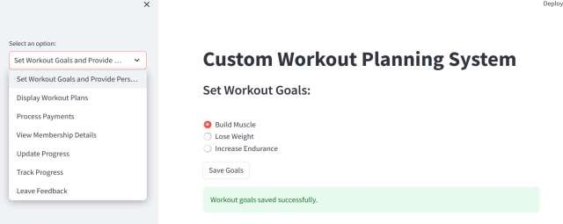
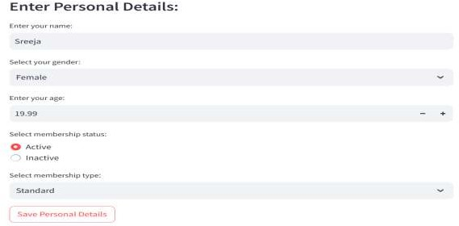
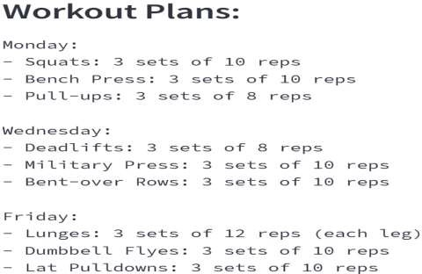
CHAPTER-7
OUTPUTS:

Slide 13
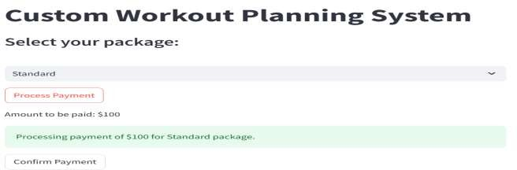
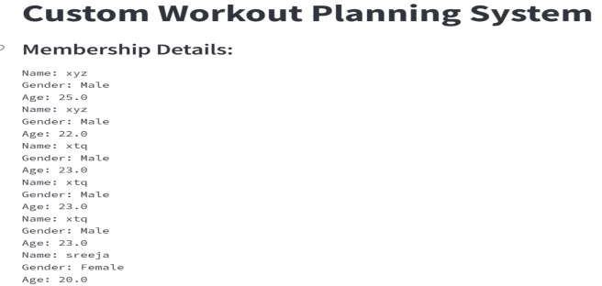
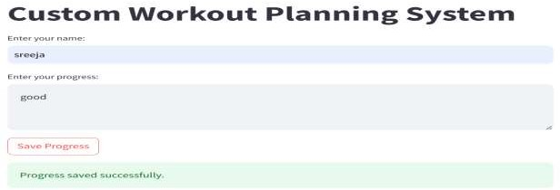

Slide 14
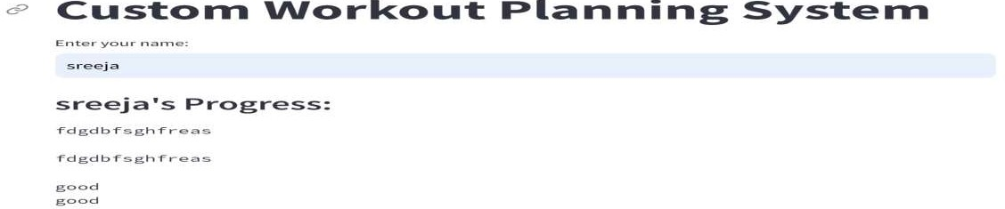
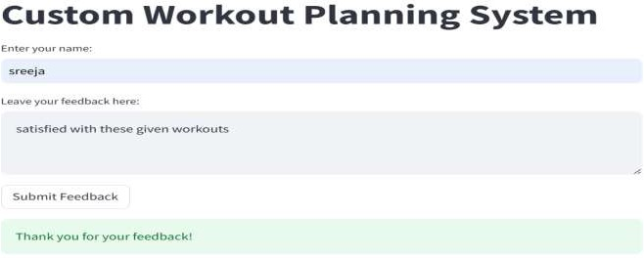

Slide 15
CHAPTER-8
CONCLUSION:
Custom workout planning can be highly beneficial for individuals aiming to achieve specific fitness goals. By tailoring a workout routine to suit an individual's unique needs, preferences, and capabilities, it increases the likelihood of adherence and success. The conclusion might emphasize the importance of consistency, proper form, and gradual progression in any workout plan. Additionally, it could highlight the significance of regularly reassessing goals and adjusting the workout plan accordingly to ensure continued progress and avoid plateaus. Ultimately, the conclusion would emphasize that while custom workout planning requires effort and dedication, the results in terms of improved fitness, health, and overall well-being are well worth it.
9

Slide 16
CHAPTER-9
REFERENCES
https://chat.openai.com/

